Slide 1

An Najah Rank
Software Graduation Project

Slide 2



Our Team
Supervisor
Dr. Samer Arandi
Momen Odeh
Noor Aldeen
Abu Shehadeh

Slide 3
Table of contents
01
Problem Statement
02
Our Solution
03
Features
04
Methodology
05
Challenges and Constraints
06
Future Work

Slide 4

What ‘s the problem?
The problem-solving skills are one of the most important skills in the workplace.
An-Najah National University strives to improve these skills in our students.
Problem solving websites lack essential features that would simplify the problem-solving process and make solution grading more efficient.

Slide 5

Our Solution
we built a problem-solving web application that combines solving problems for students and adds the educational features needed for professors, making the process more straightforward.

Slide 6

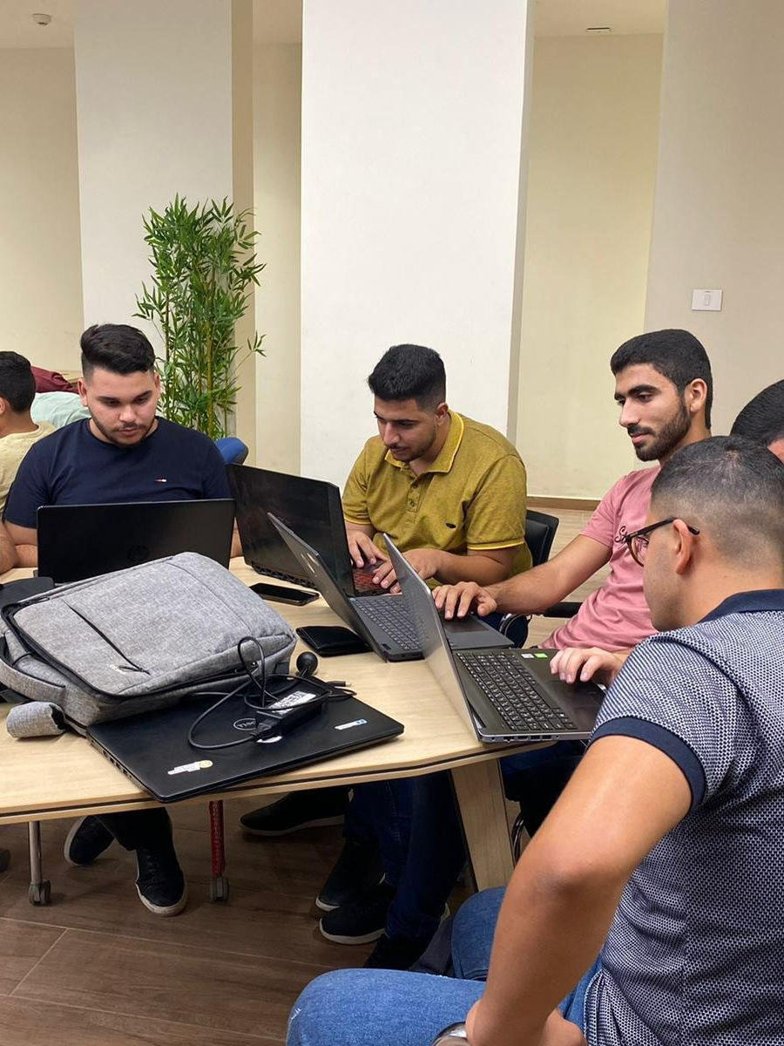

Who use web application ?
Professors
Students
Admin

Slide 7
Features
01
02
03
Registration & login
Admin
Course Management
04
05
06
Manage test cases of Challenge
Code operation
Similarity
07
08
09
Track submissions
Manual Mark
Chatting & Notification

Slide 8

Methodology
Software Development Life Cycle:

Slide 9
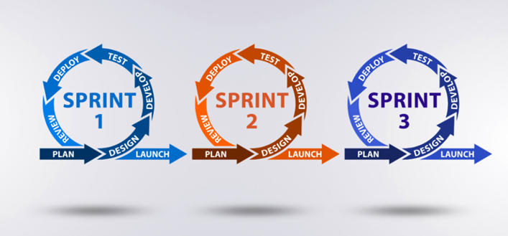
Methodology (cont.)
Agile Methodology:

Slide 10

Planning Phase
We met with our client Dr. Samer Arandi.
We explored various problem-solving websites.
explored new functionalities to enhance the project.

Slide 11

Analysis Phase
Gathering and Documenting Requirements through stakeholder engagement and user feedback sessions.
Crafting user stories to clearly outline specific functionalities.
Envisioning the system's architecture using Unified Modeling Language (UML) diagrams.

Slide 12
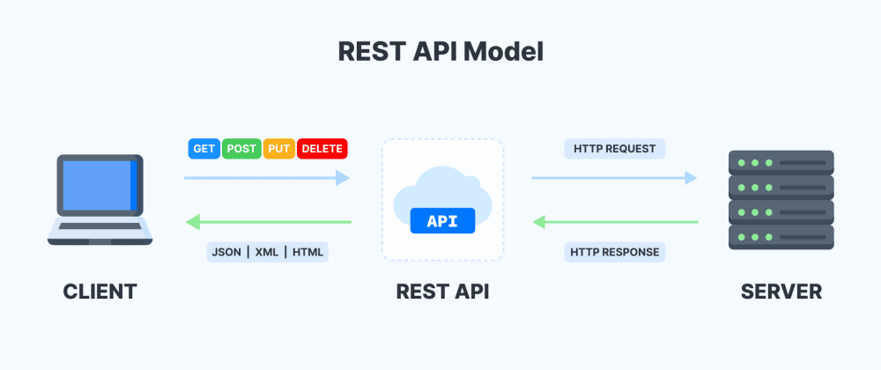
Design Phase
Architectural Style:

Slide 13
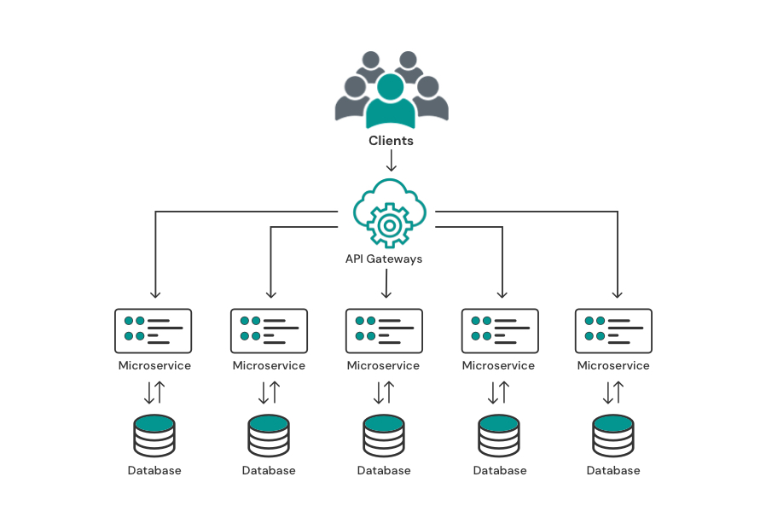
Design Phase (cont.)
Architectural Pattern:
Microservice Architectural pattern

Slide 14








Design Phase (cont.)
Frontend libraries:
Backend technologies :

Slide 15







Design Phase (cont.)
DevOps tools:
AWS Cloud Formation:

Slide 16
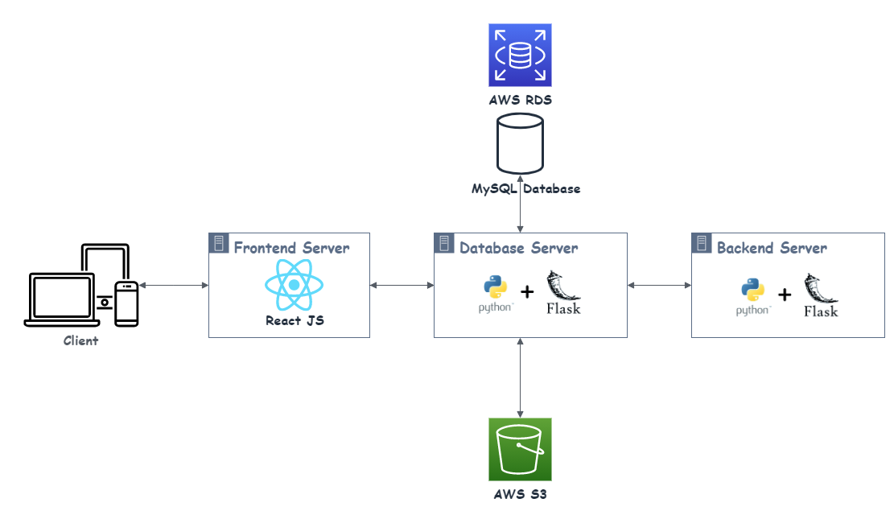
Design Phase (cont.)
Project Structure:

Slide 17




Security
Authentication: verifying a user or device before allowing access to web application.
Authorization: giving the user permission to access a specific page.
CORS policies: a mechanism that allows restricted resources on a web page to be accessed from another domain outside the domain from which the first resource
Library used:

Slide 18
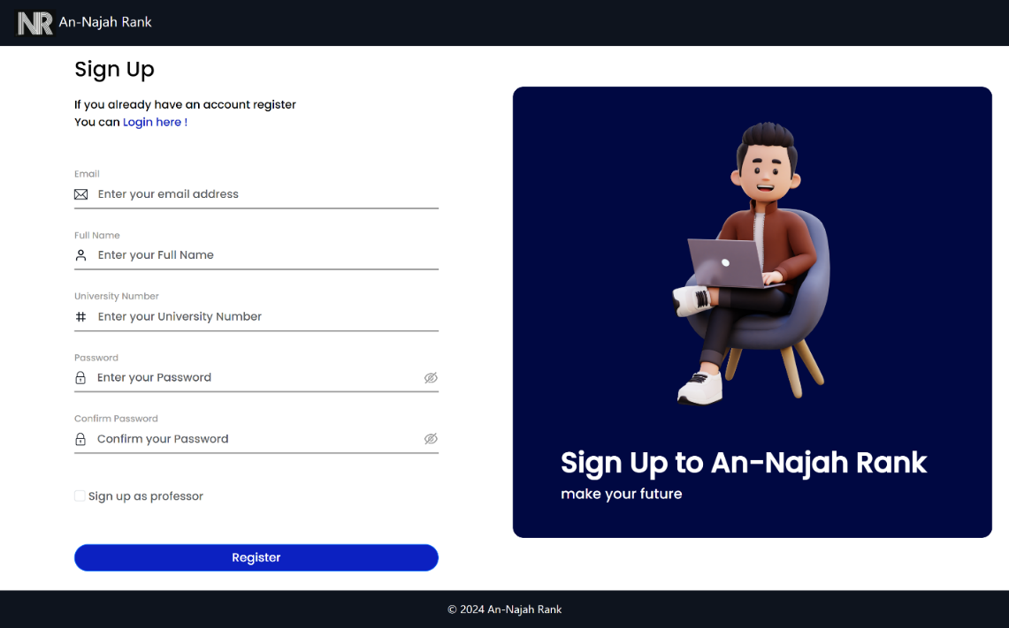
User Features
Registration:

Slide 19
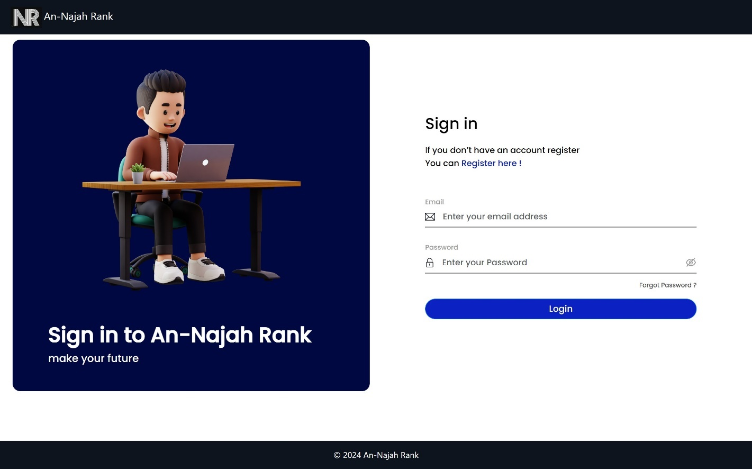
User Features
Sign in:

Slide 20
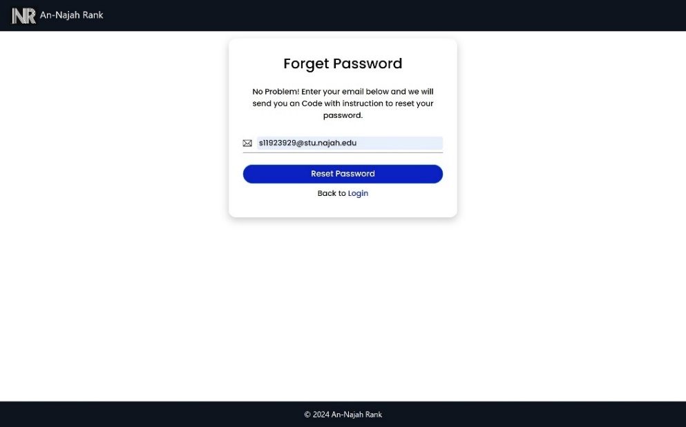
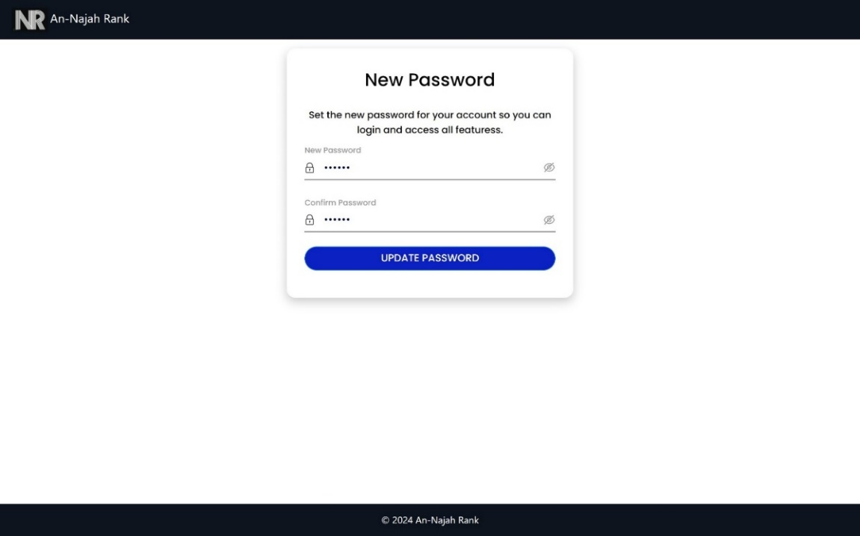
User Features
Forget password:

Slide 21
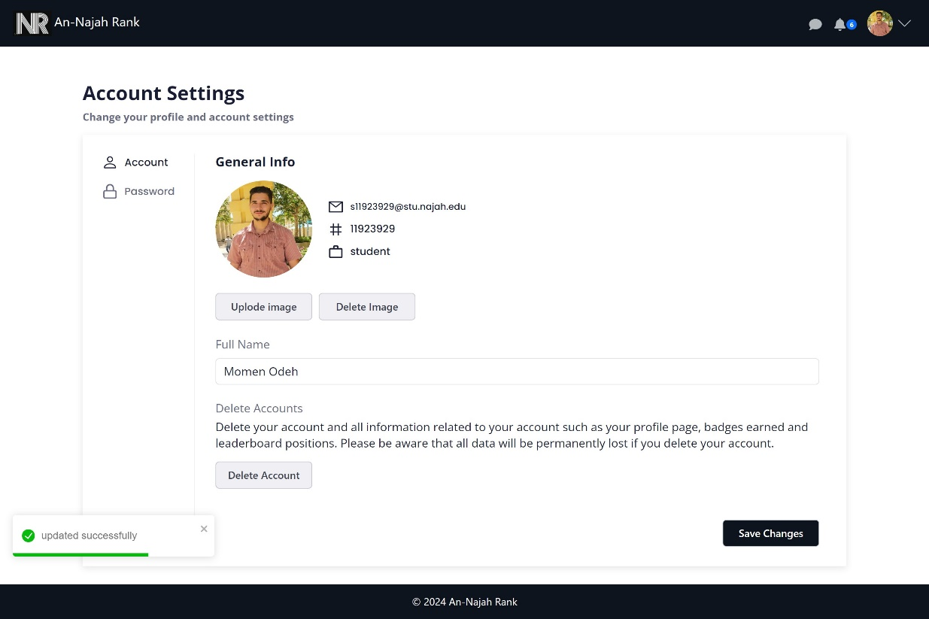
User Features
Account Settings:

Slide 22
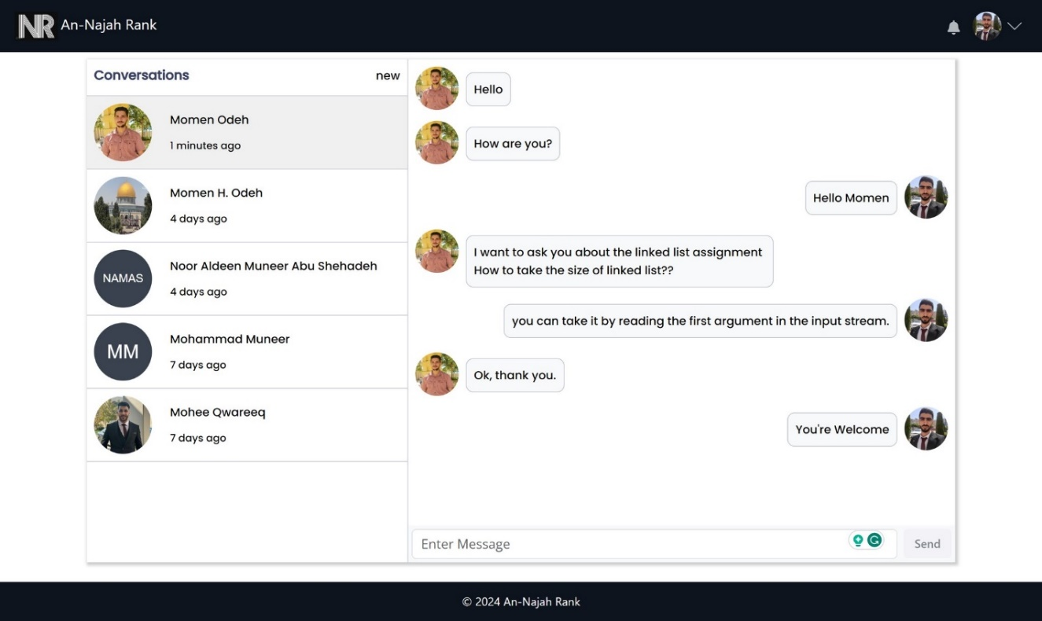
User Features
Chatting:

Slide 23
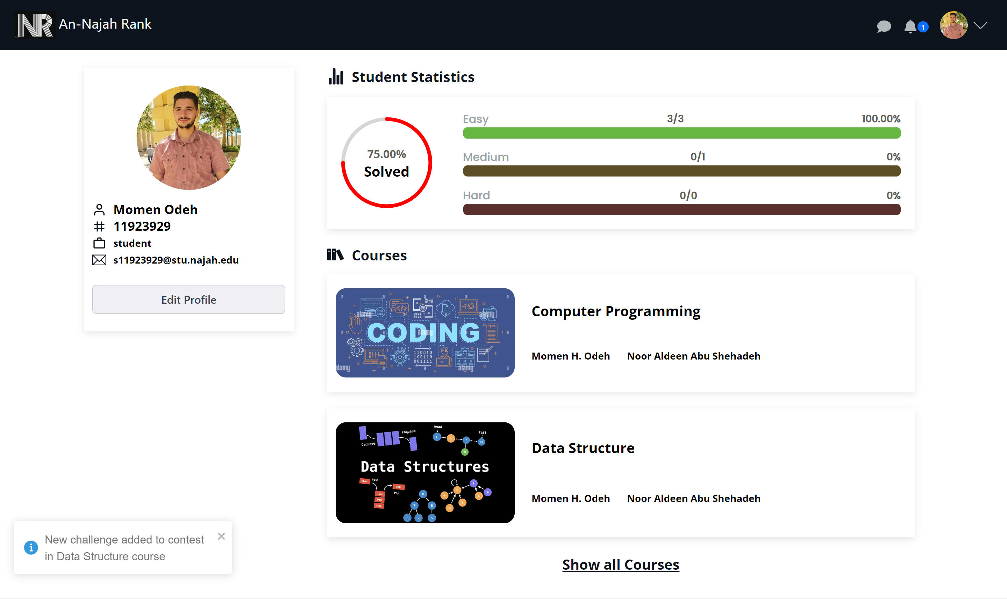
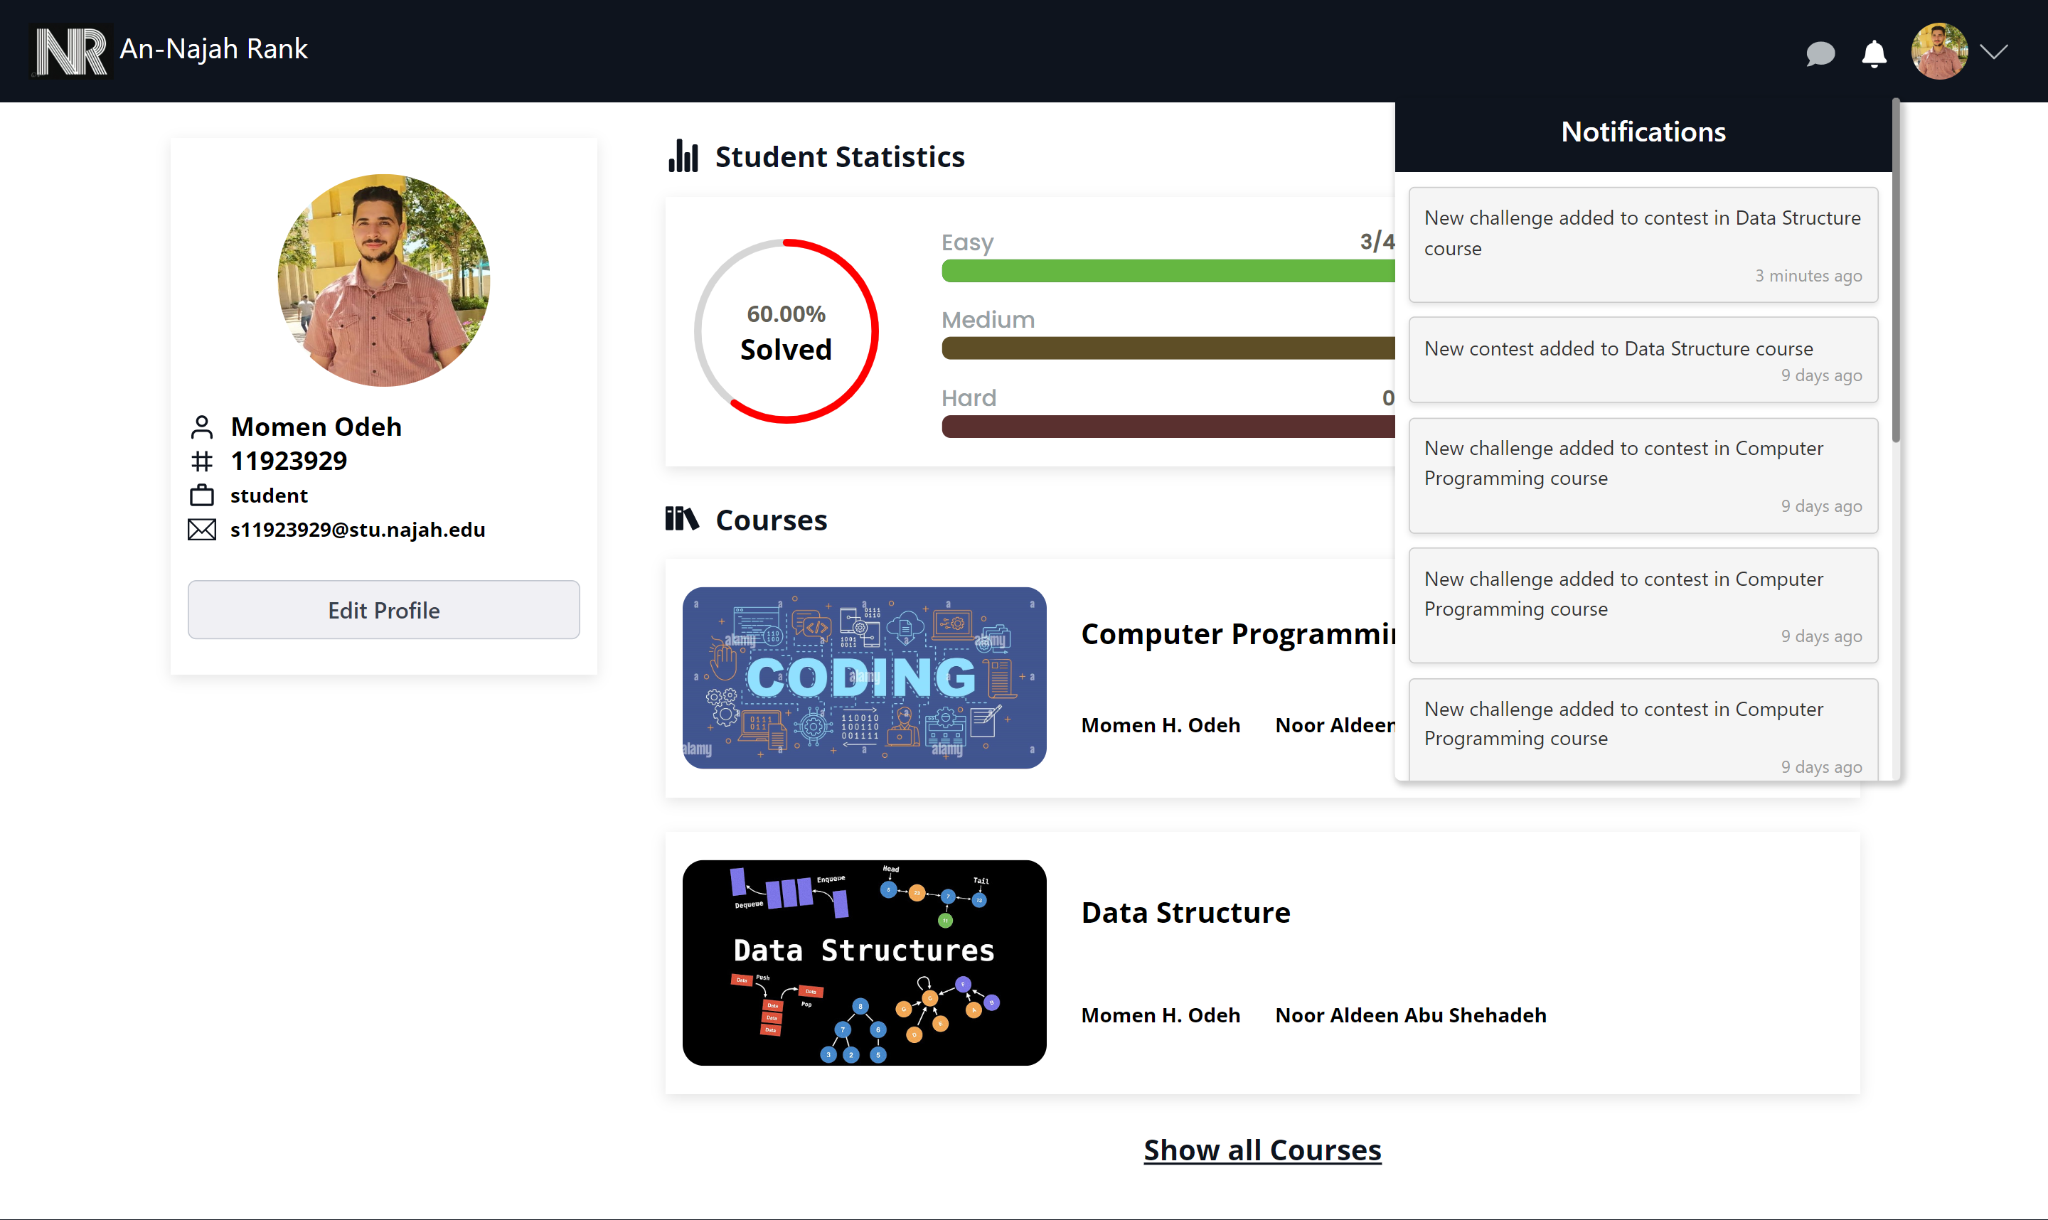
User Features
Notifications:

Slide 24
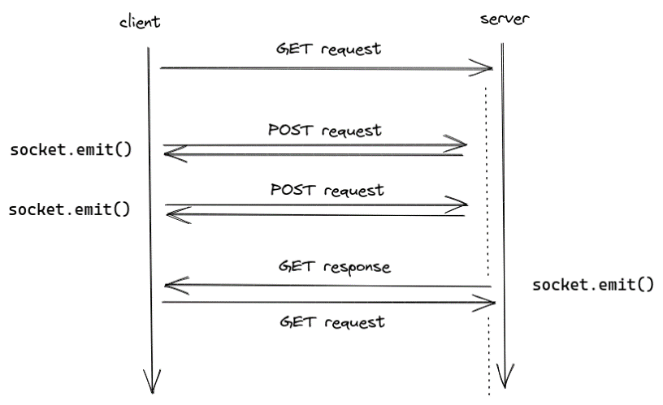
User Features
Socket IO:

Slide 25
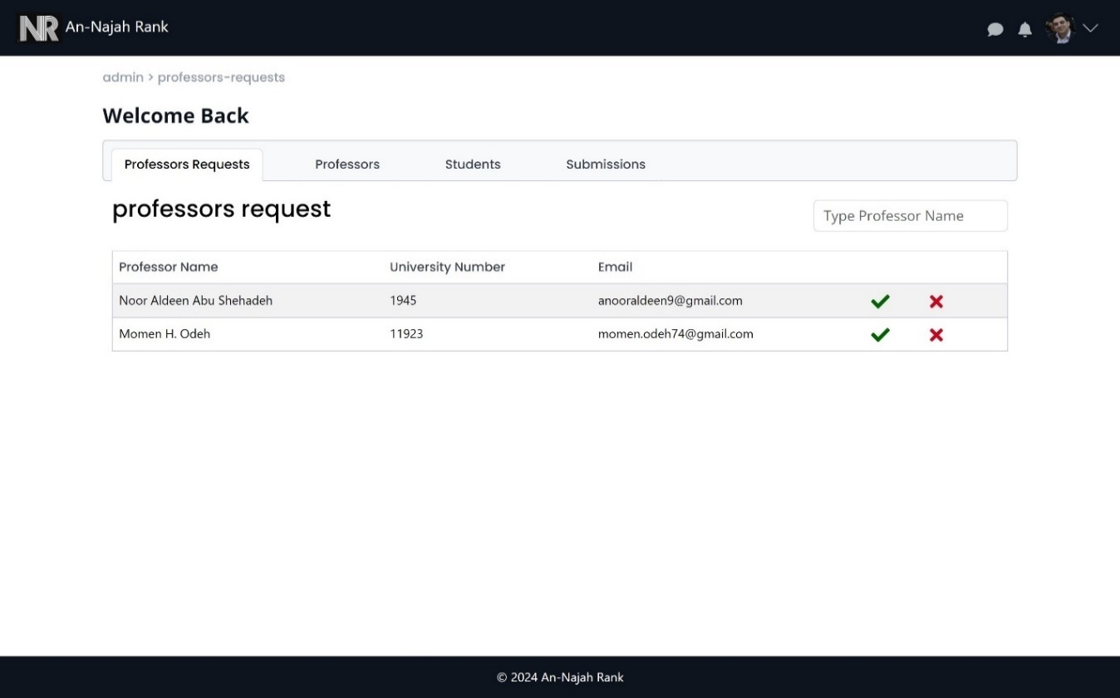
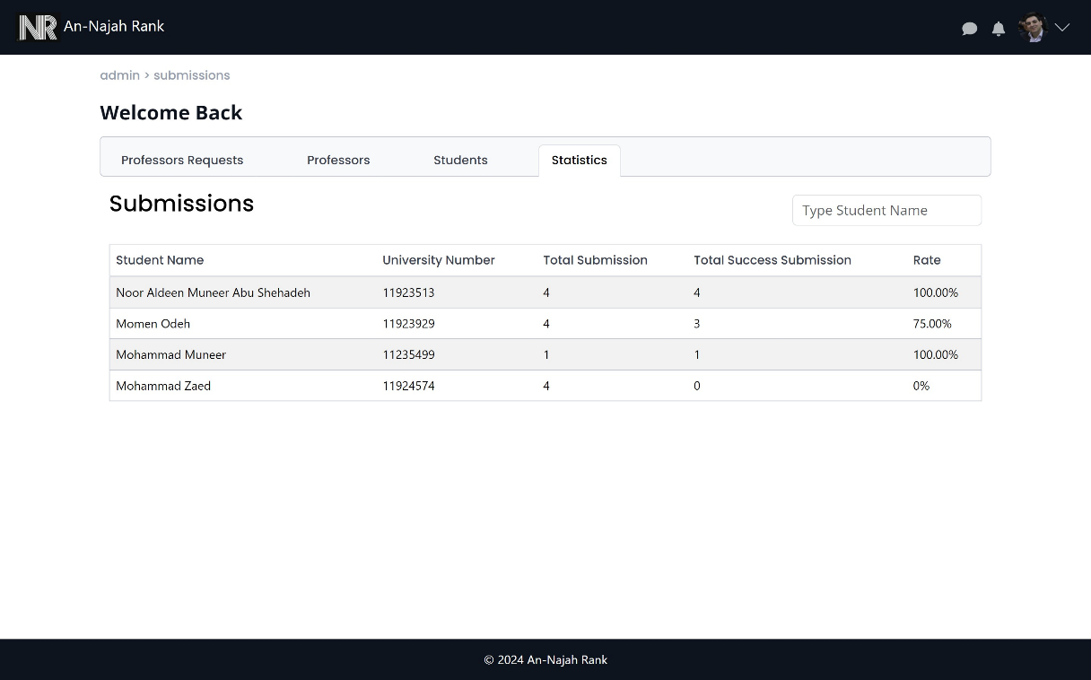
Admin Features
pending professors
Students statistics

Slide 26
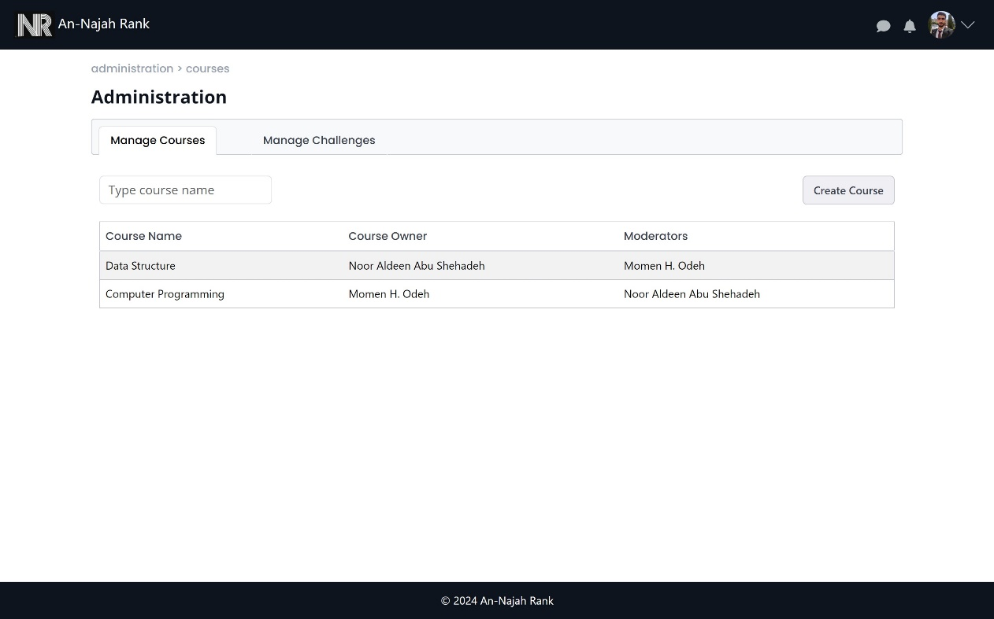
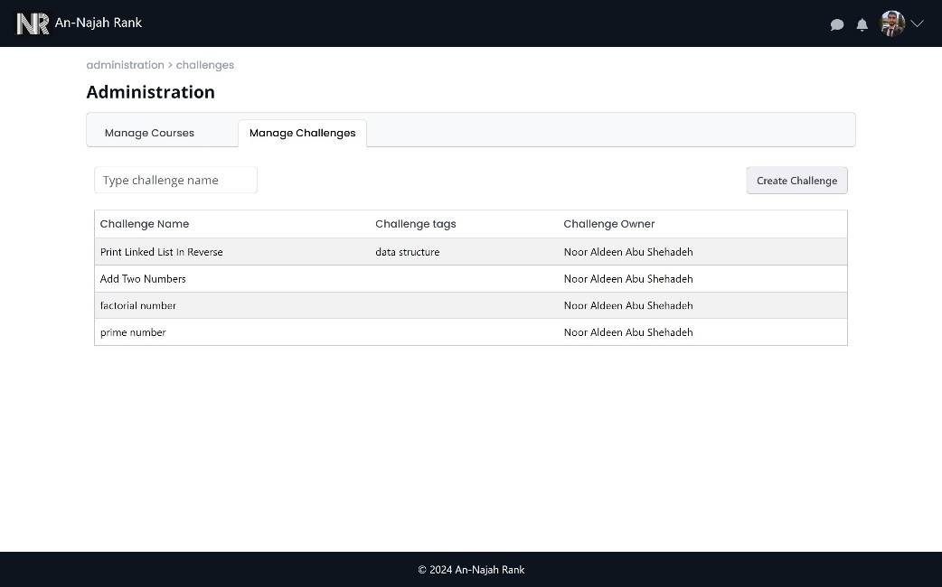
Professor Features
Mange Courses
Mange Challenges

Slide 27
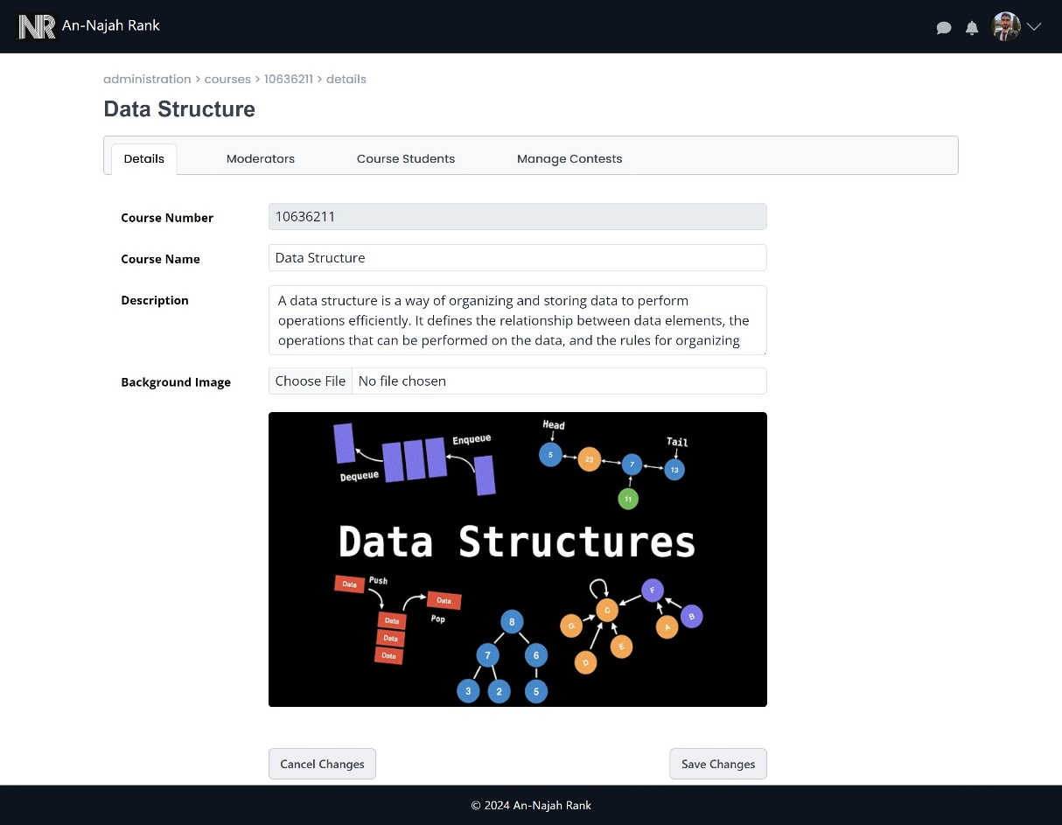
Professor Features (cont.)
course Management:

Slide 28
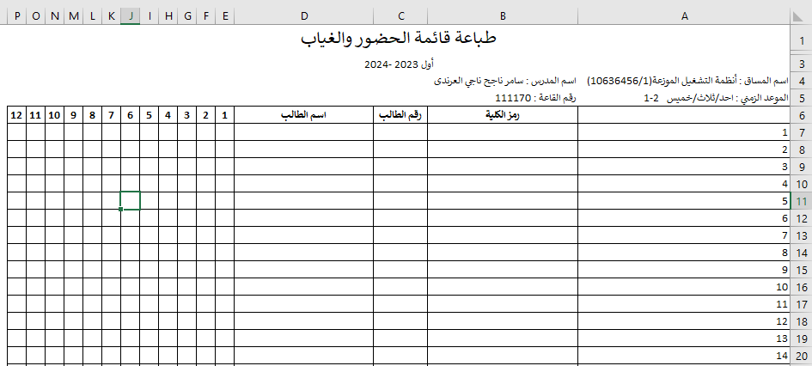
Professor Features (cont.)
Add students to course

Slide 29
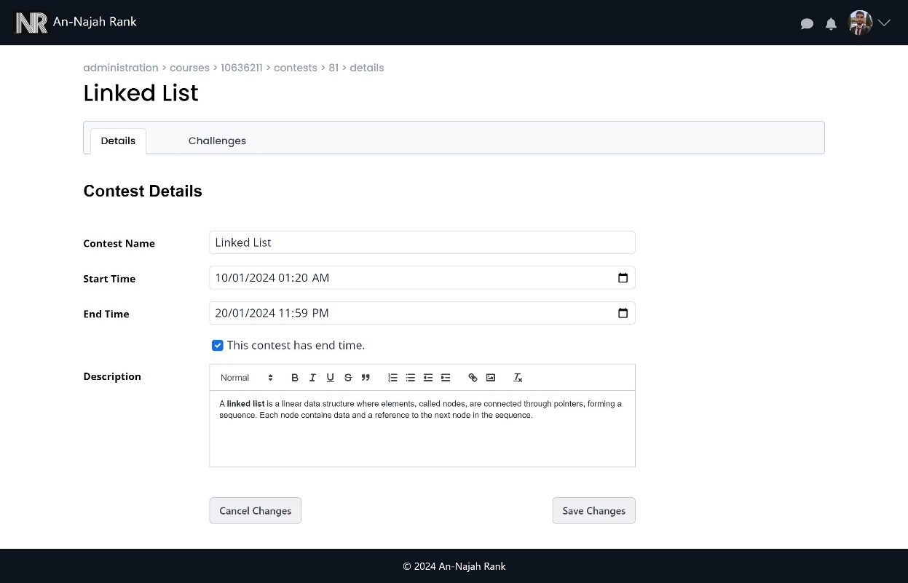
Professor Features (cont.)
Contest Management :

Slide 30
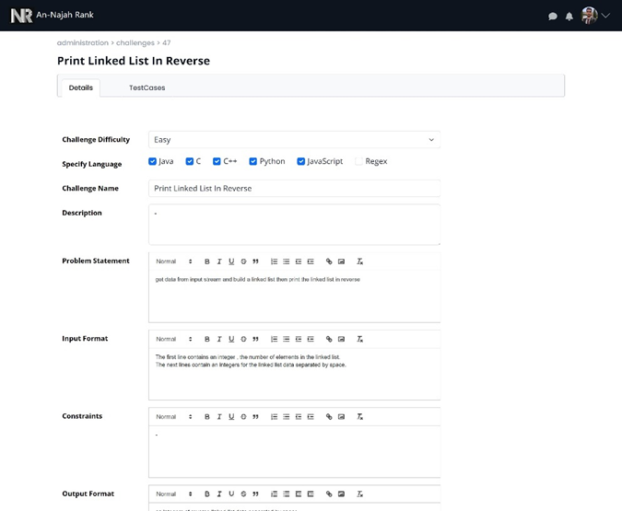
Professor Features (cont.)
Challenge Management :

Slide 31
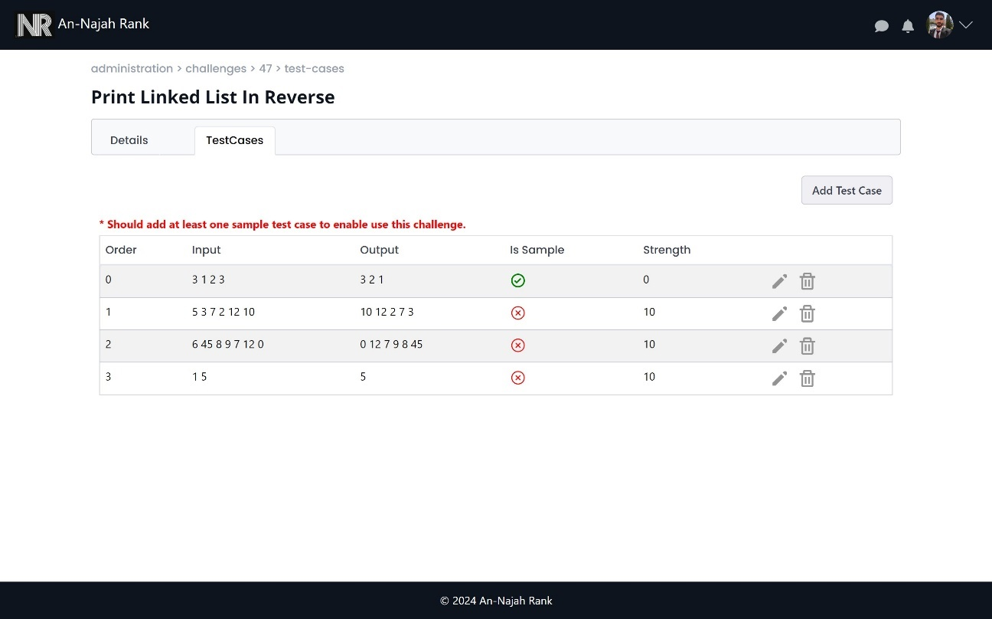
Professor Features (cont.)
Manage test cases in challenge

Slide 32
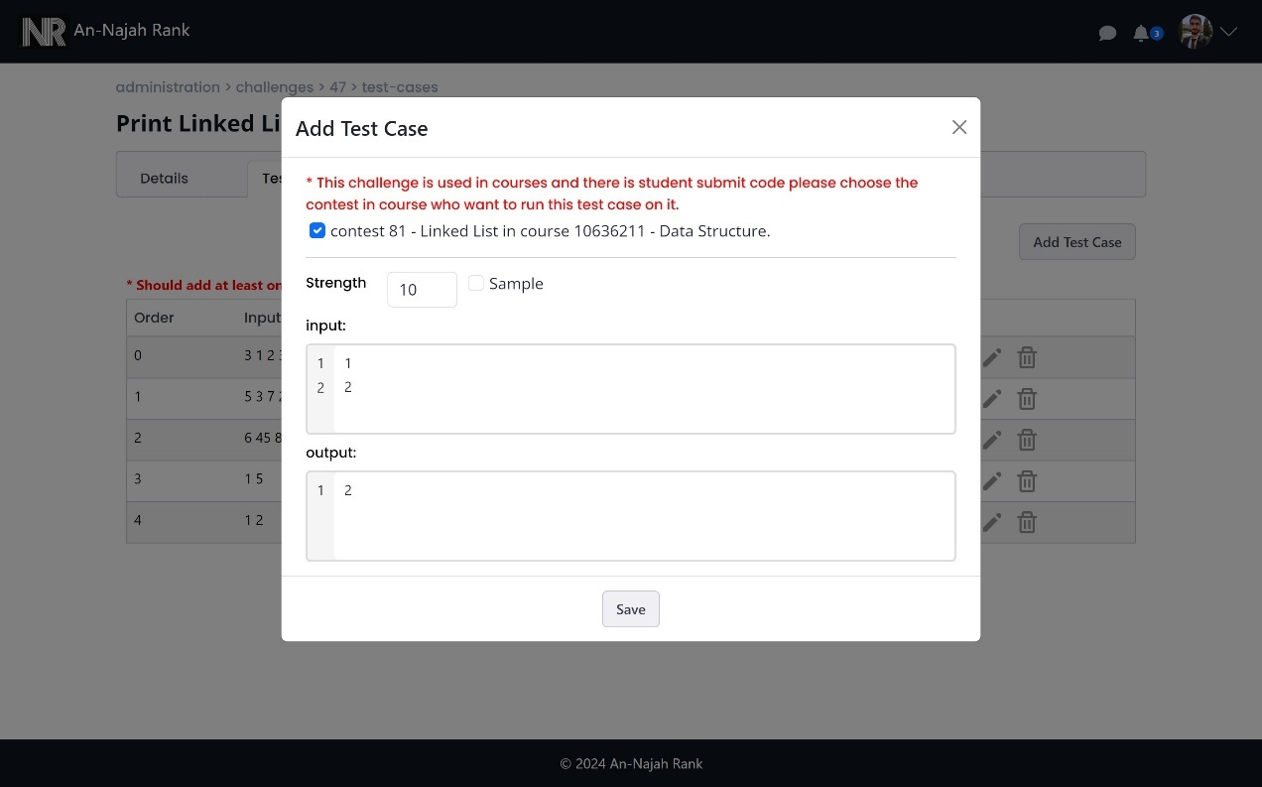
Professor Features (cont.)
Add new test case when there is a submission for challenge

Slide 33
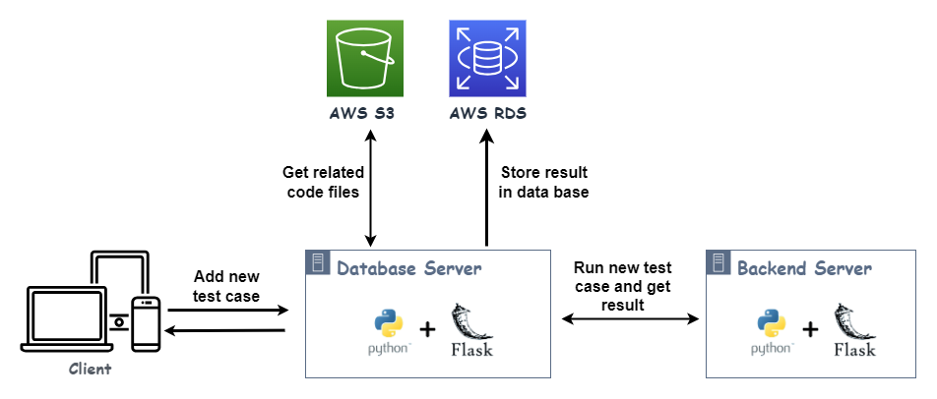
Professor Features (cont.)
Add new test case when there is a submission for challenge (cont.)

Slide 34
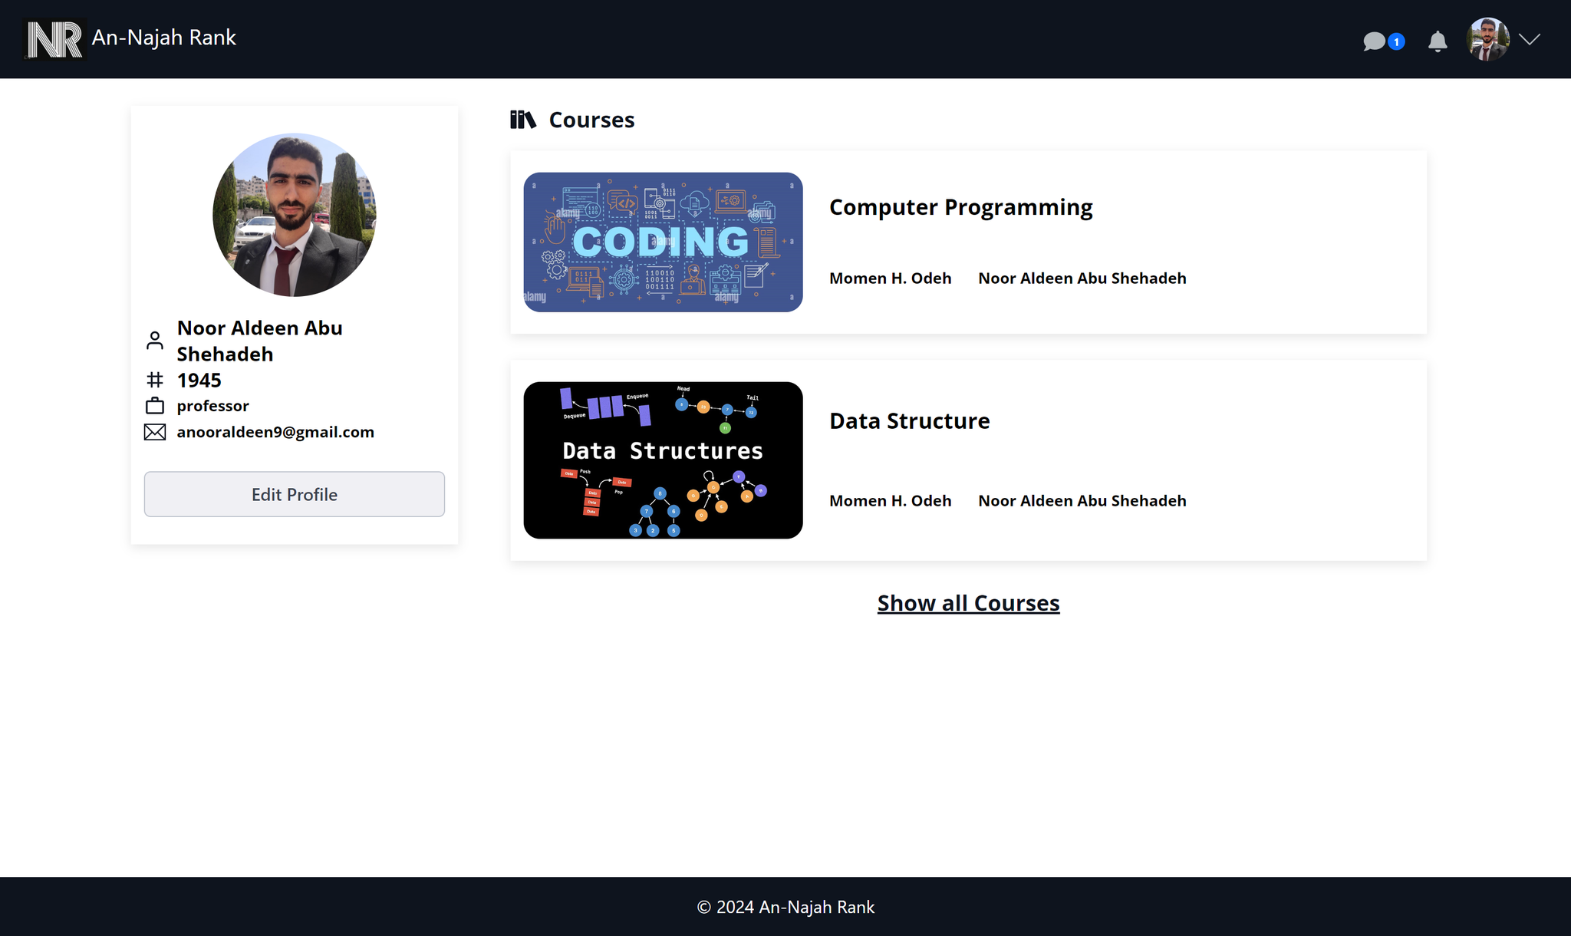
Professor Features (cont.)
Profile:

Slide 35
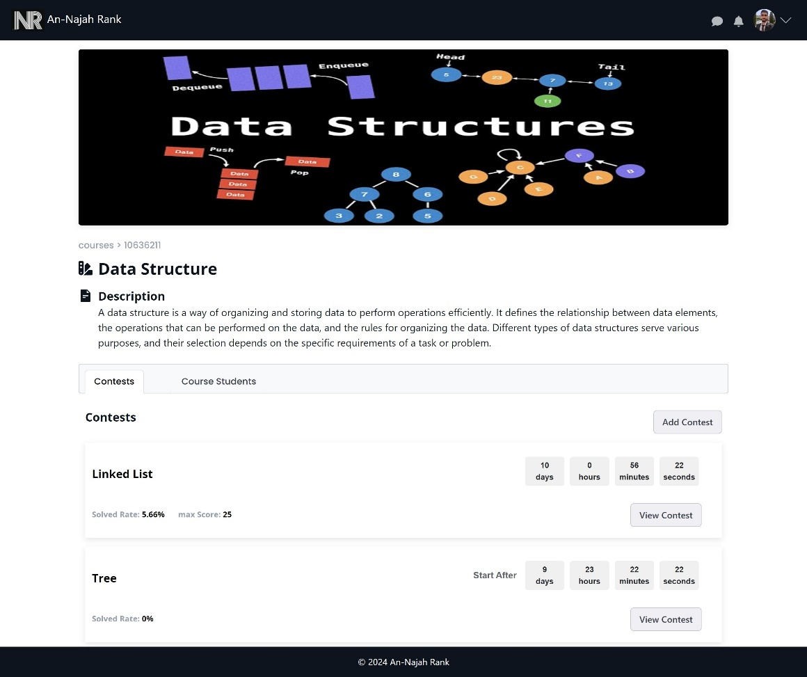
Professor Features (cont.)
Course View:

Slide 36
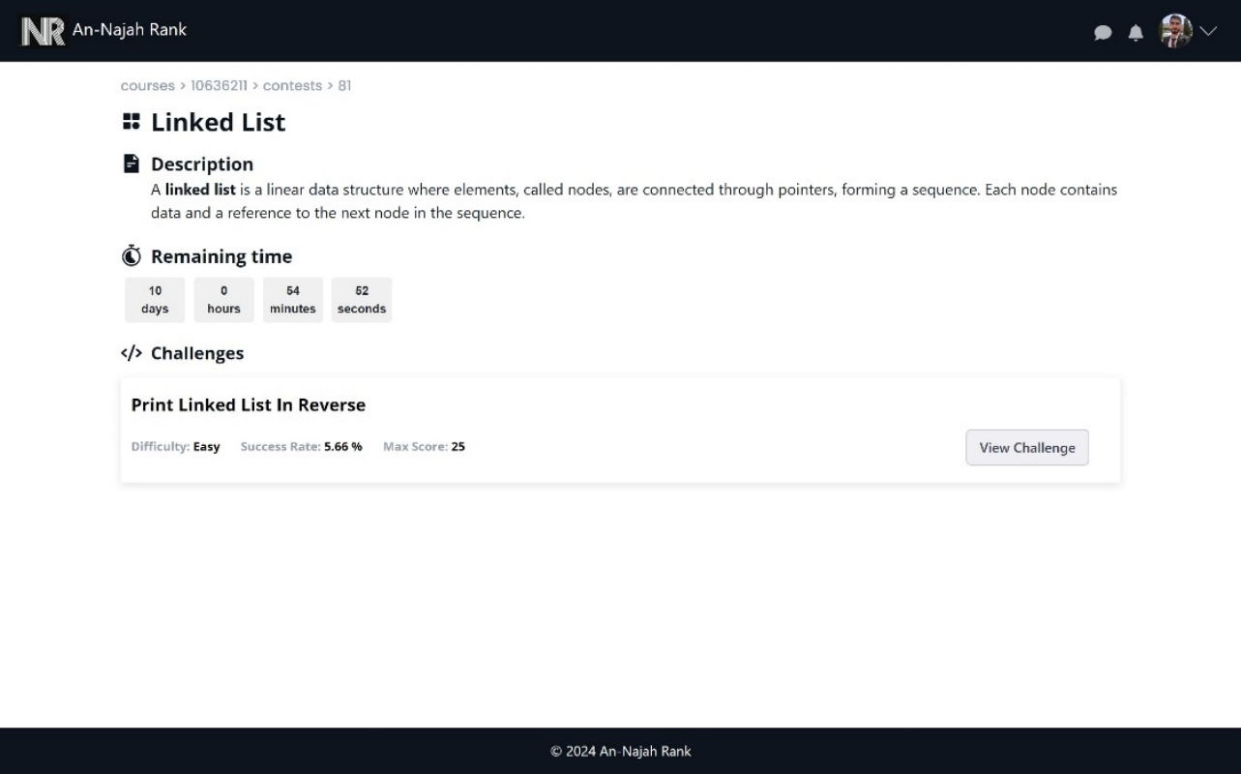
Professor Features (cont.)
Contest View:

Slide 37
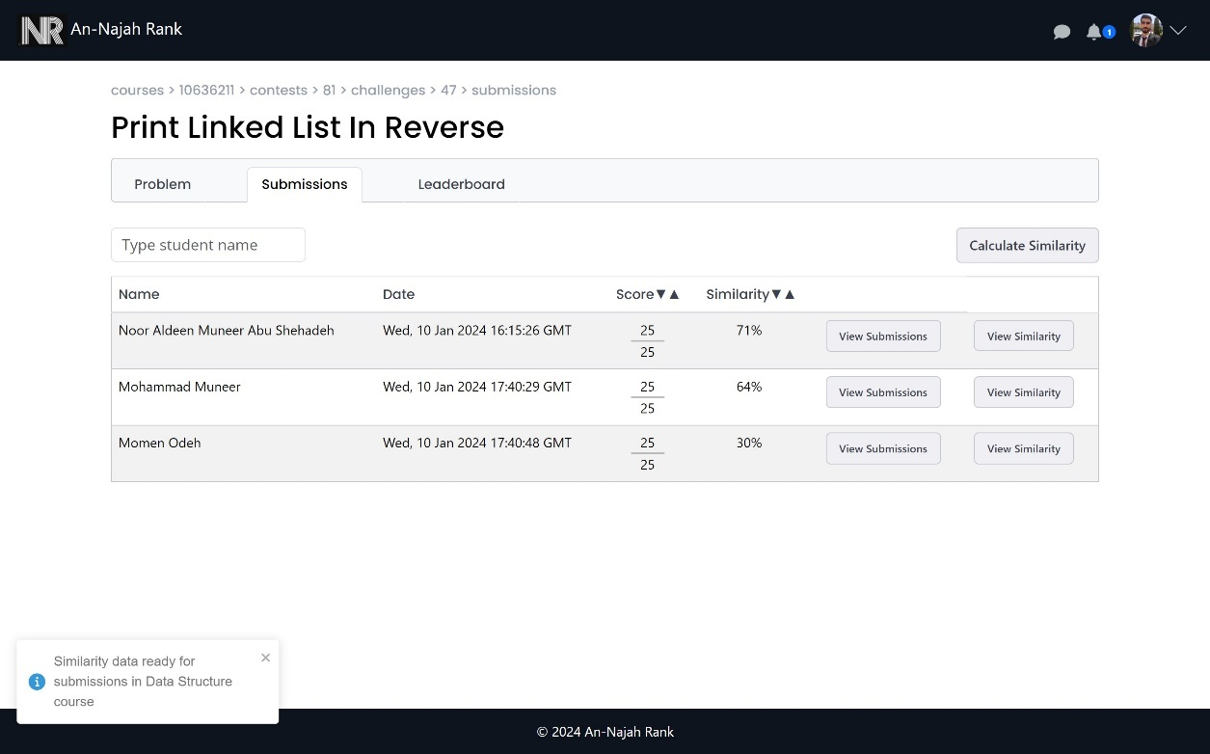
Professor Features (cont.)
Challenge submission View:

Slide 38
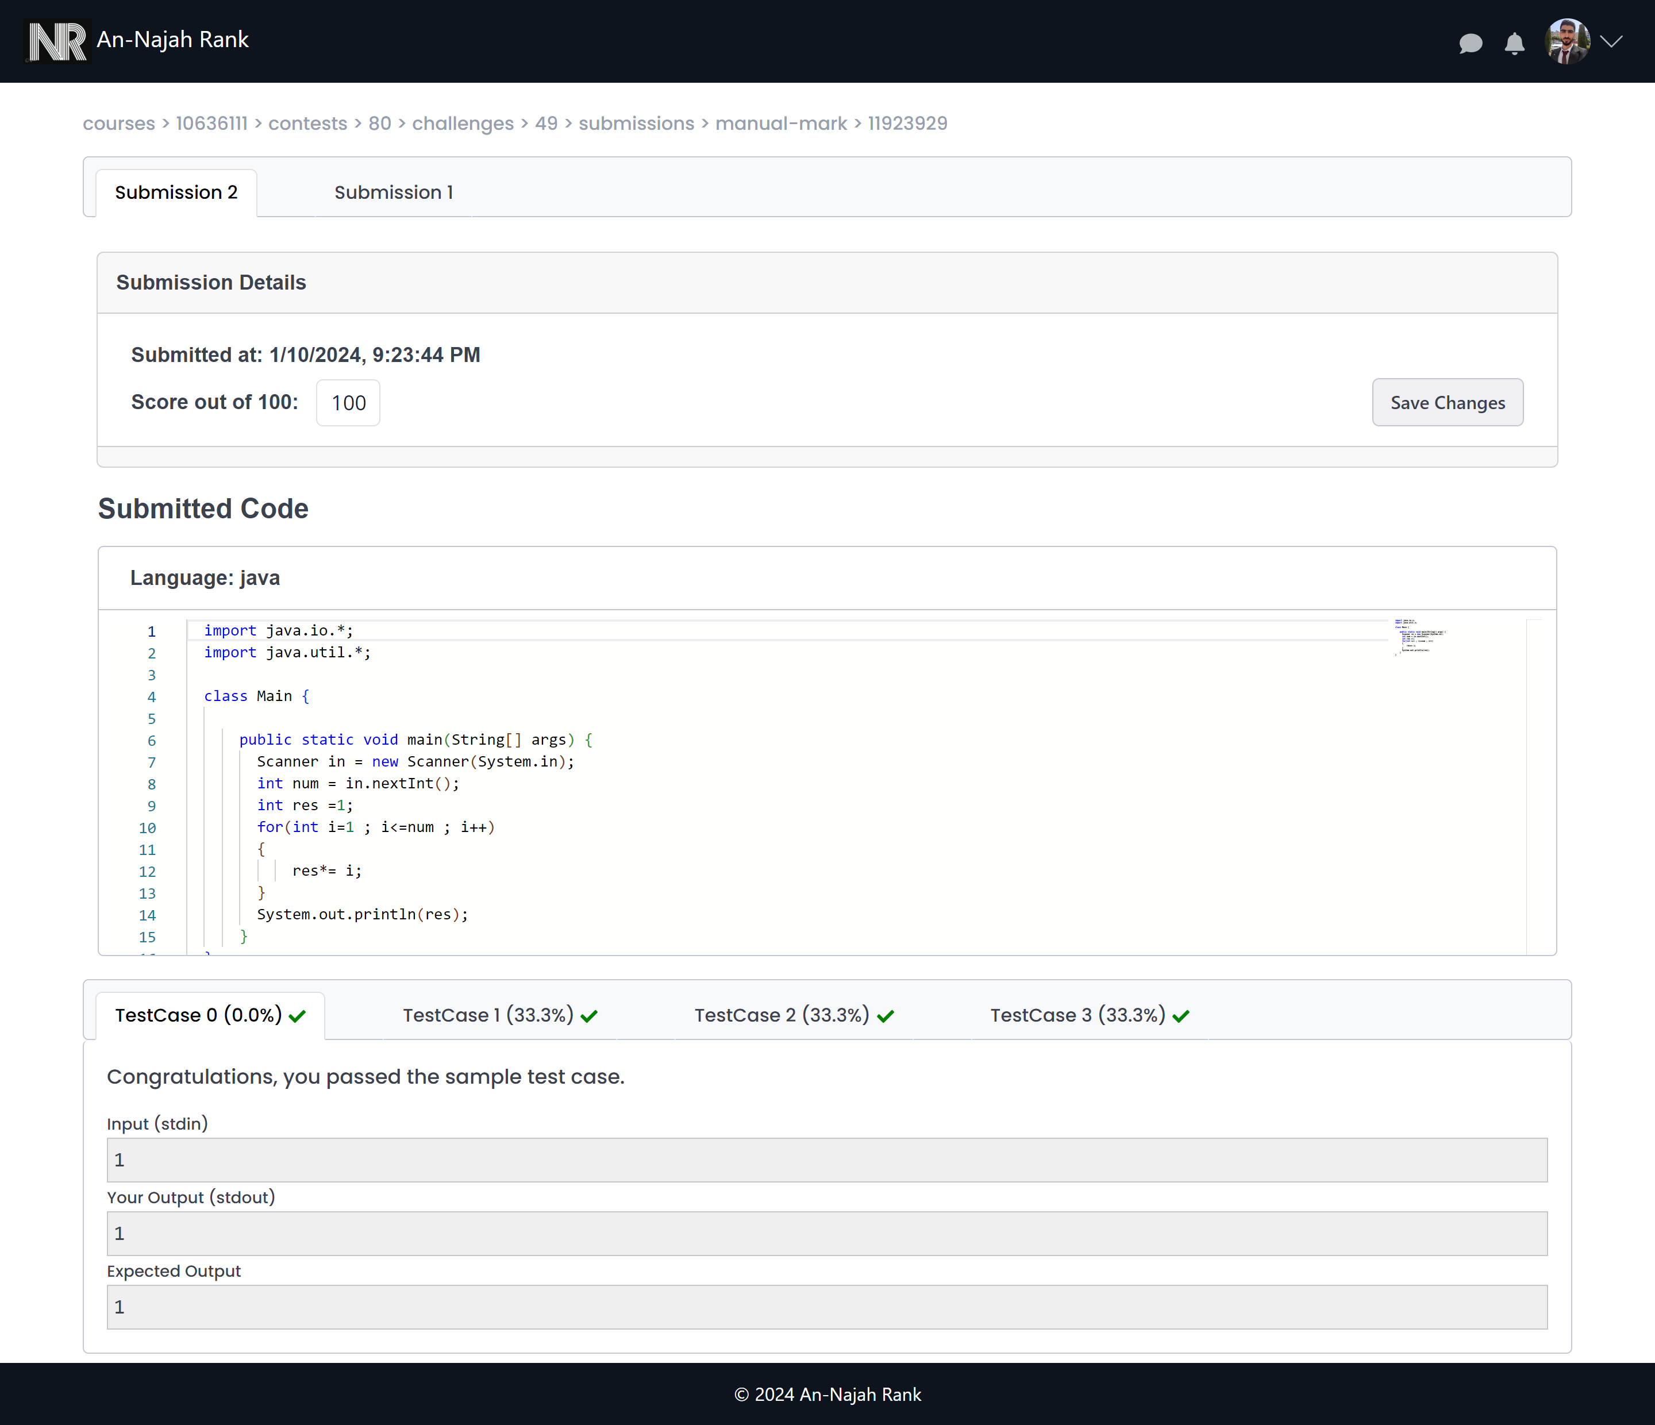
Professor Features (cont.)
Challenge student submissions View:

Slide 39
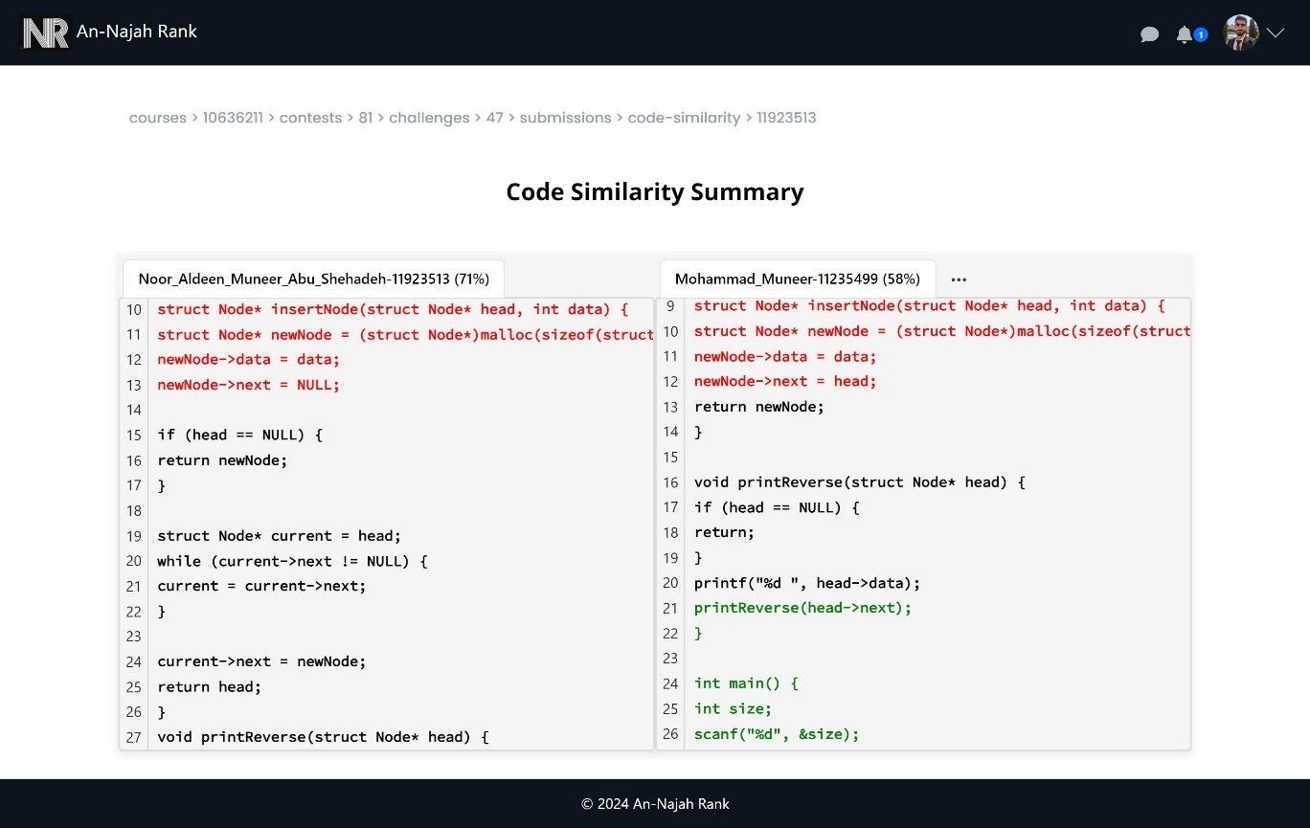
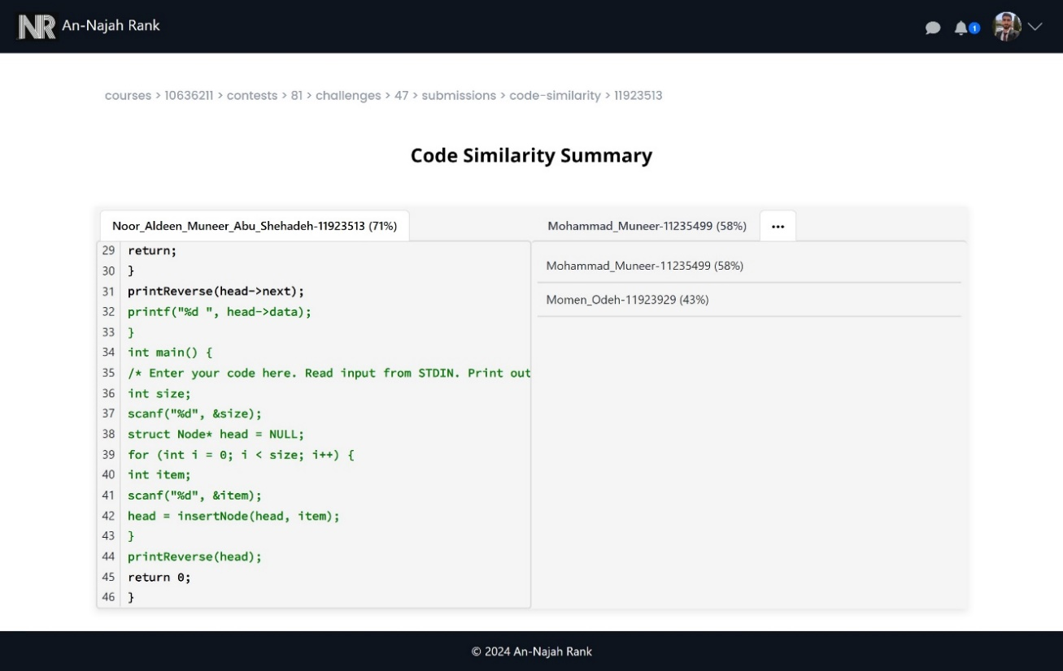
Professor Features (cont.)
Challenge student similarity View:

Slide 40
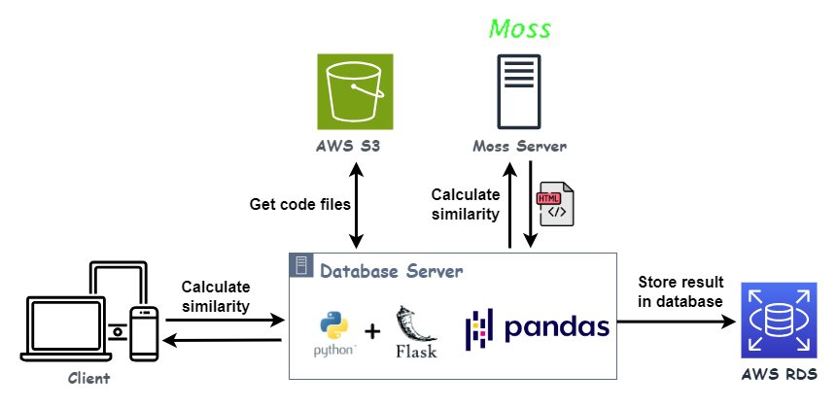
Professor Features (cont.)
Challenge student similarity View (cont.):

Slide 41
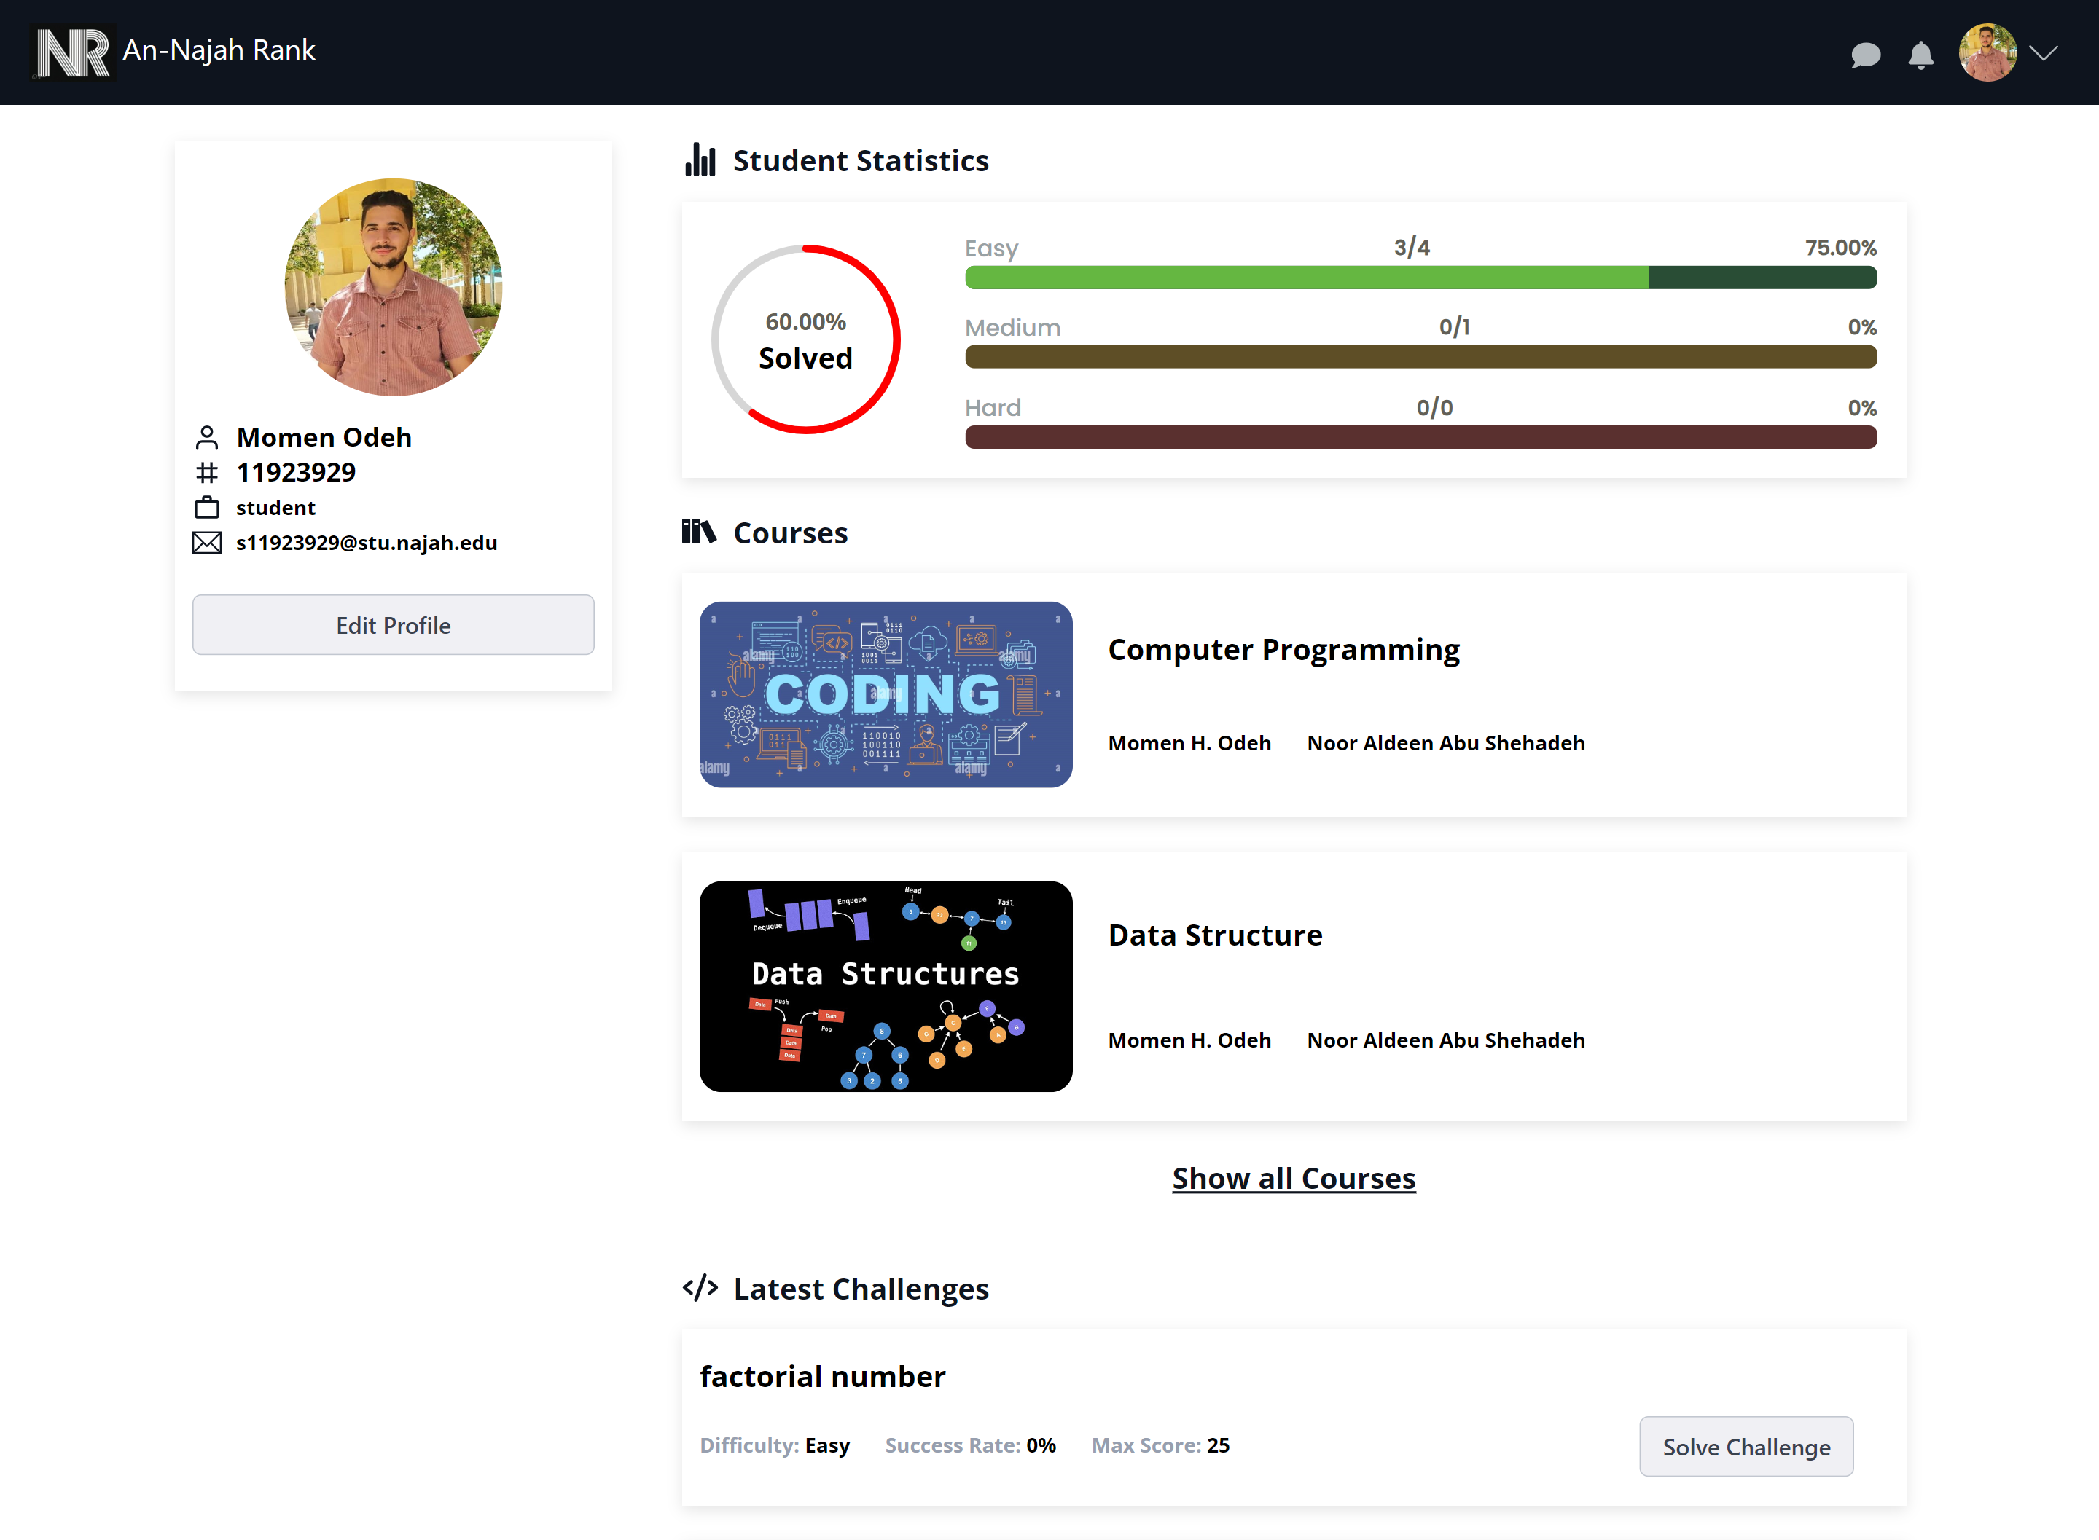
Student Features
Student Profile:

Slide 42
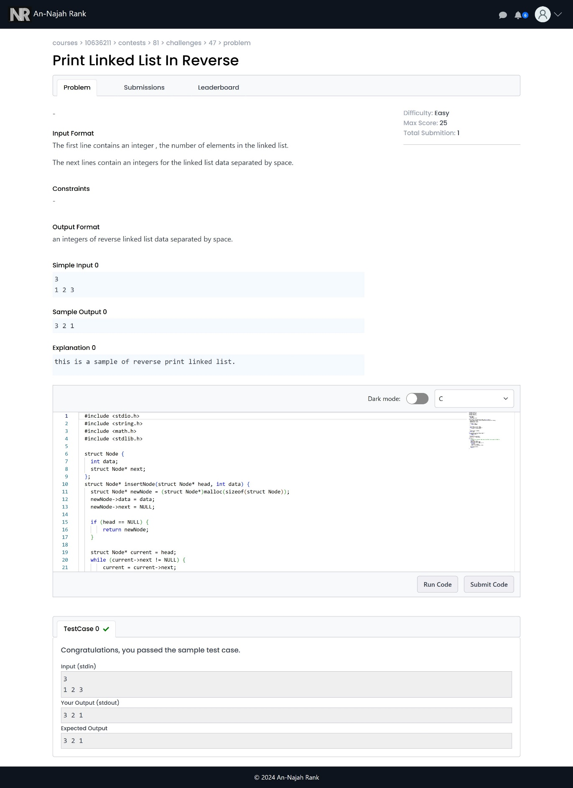
Student Features
Solving challenge:

Slide 43
Student Features
Code operation:

Slide 44
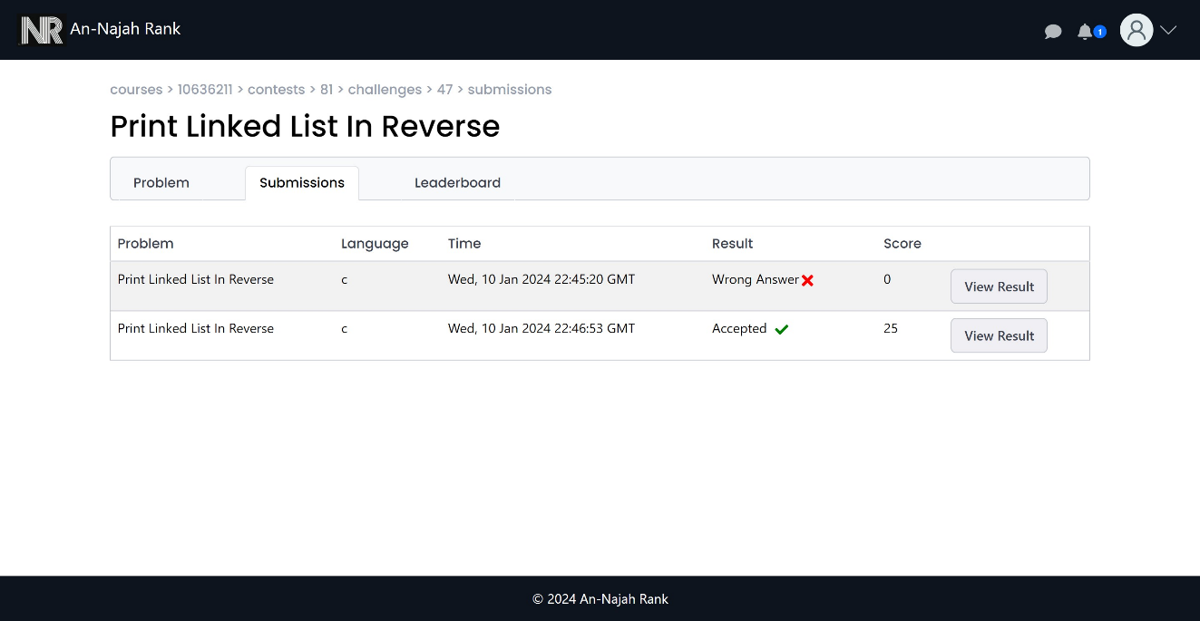
Student Features
Student submission:

Slide 45
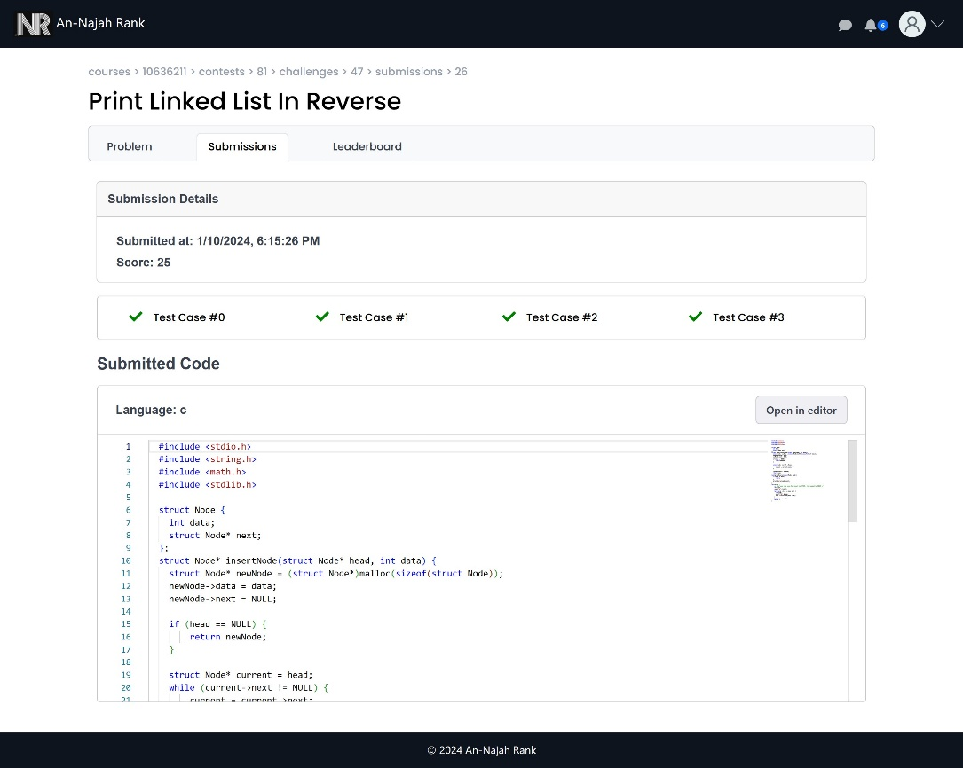
Student Features
Student submission (cont.):

Slide 46
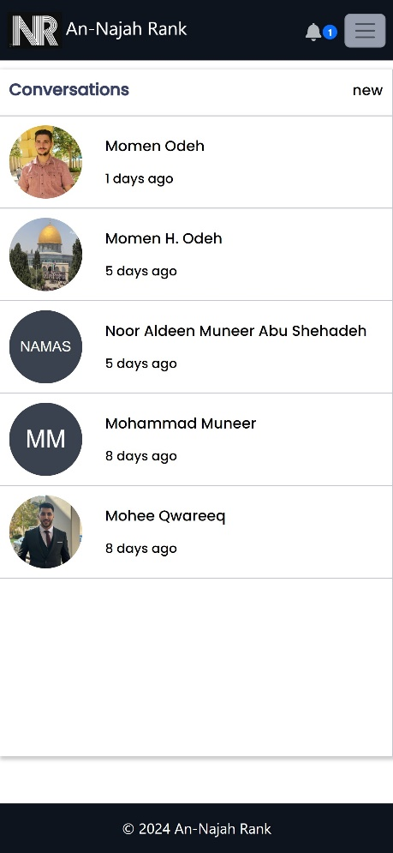
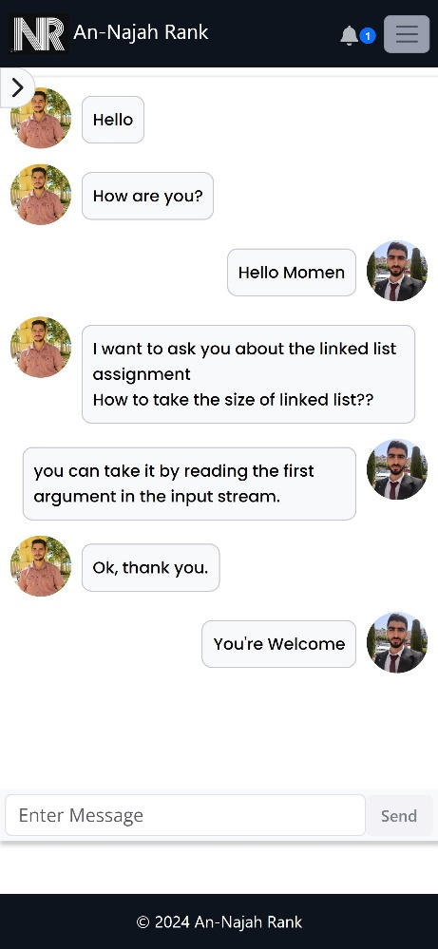
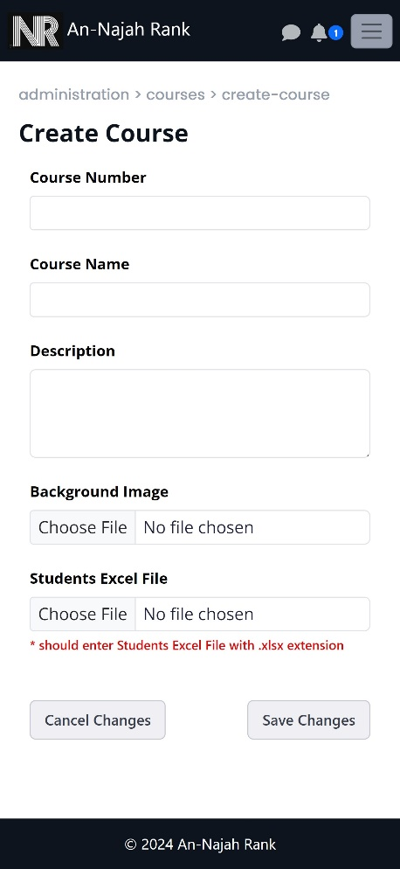

Sample of responsive design

Slide 47
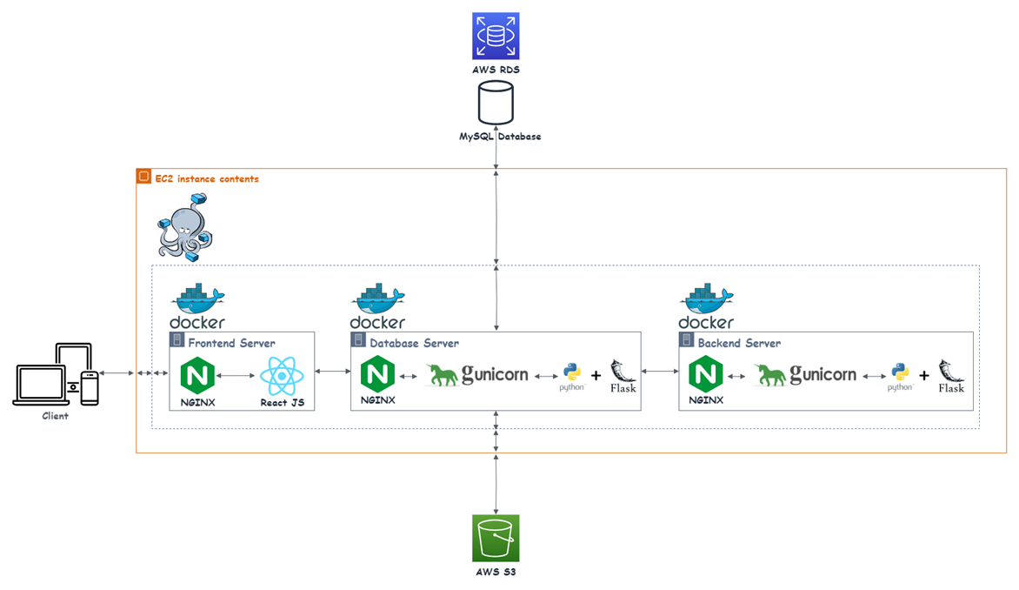
Deployment Phase

Slide 48

Testing Phase
After implementing the project, we conduct manual testing for all features in the system to ensure that all features work correctly.

Slide 49
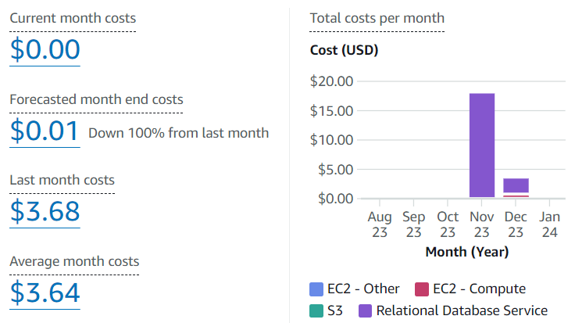
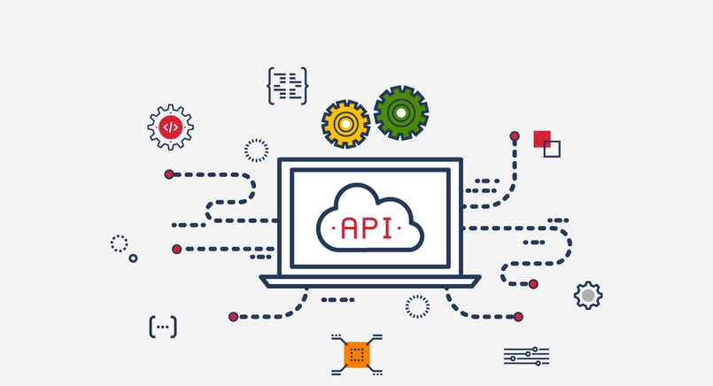
Constraints
In our AWS environment, not all services come without costs certain services like RDS, EC2, and Elastic IP Addresses require payment.
Another challenge we face involves a third-party API we use for similarity calculations. This API returns data in an incompatible format, necessitating thorough analysis and refactoring to align it with our requirements.

Slide 50

Future Works
Support time complexity as constrain for challenge.
Support creating a challenge related to image processing.

Slide 51
Thank You !

